Slide 1


Experiment 13
Delta-Delta Transformer –
High Resistance Grounded System
with Wye-Delta transformer – Ground Fault
Dr. Norbert Doerry and Dr. John V. Amy Jr.
http://doerry.org/norbert/MarineElectricalPowerSystems/index.htm
© 2024 by Norbert Doerry and John Amy
This work is licensed via: CC BY 4.0 (https://creativecommons.org/)

Slide 2
Schematic
C_{p} = 2.2 µF
R = 1200 Ω
R_{L} = 300 Ω
Rg = 400 Ω
N = 5.2
R_{G} = 400 Ω
Common Mode Current Probe
Current Meter (all phases)
Voltage Meter (all phases)

Slide 3
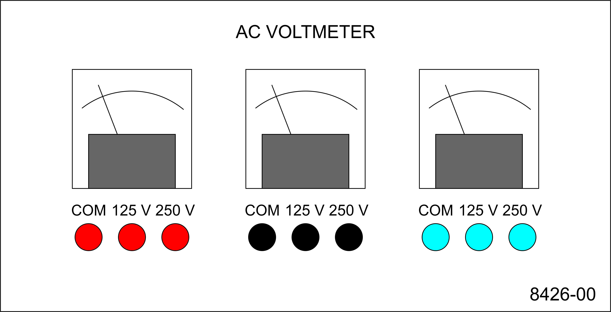
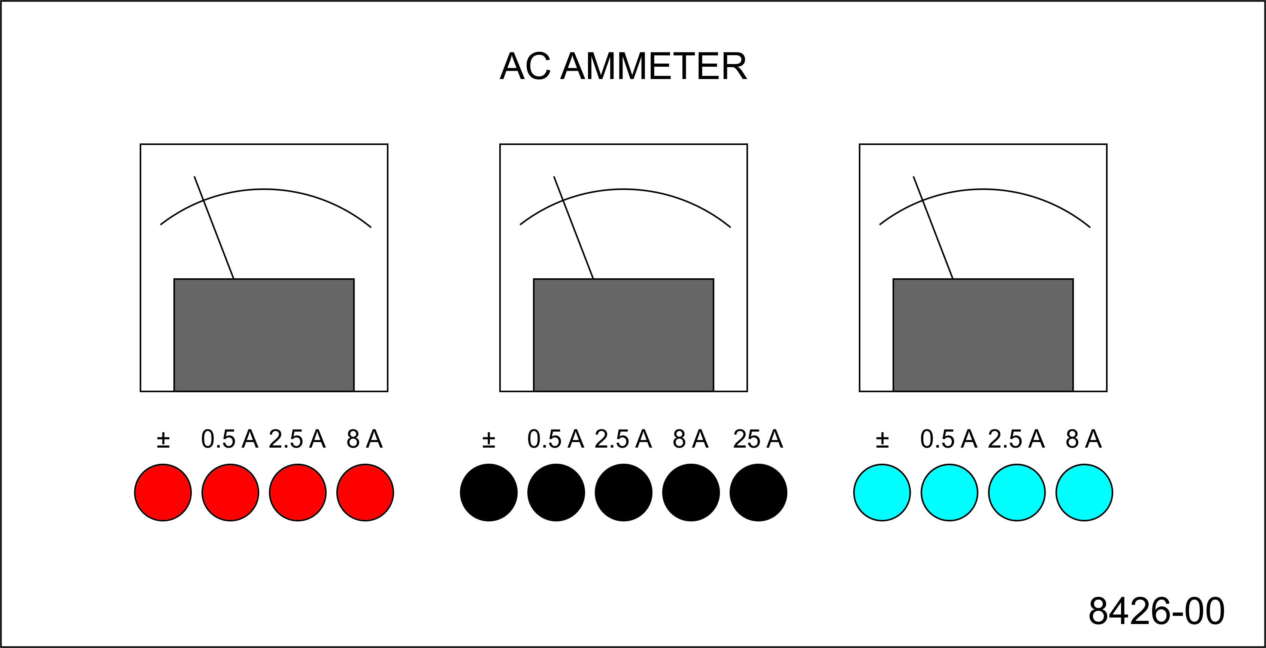
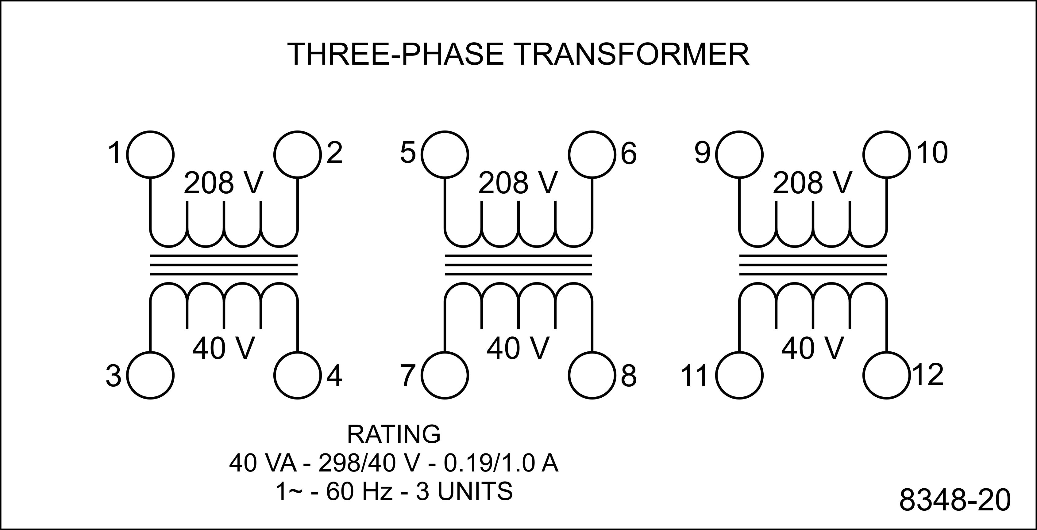
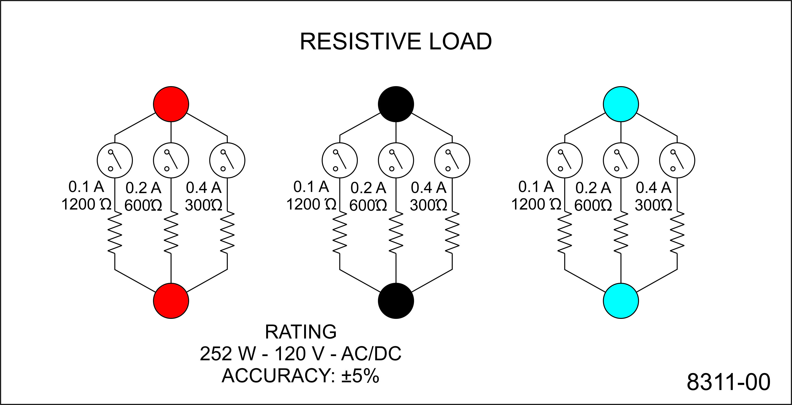
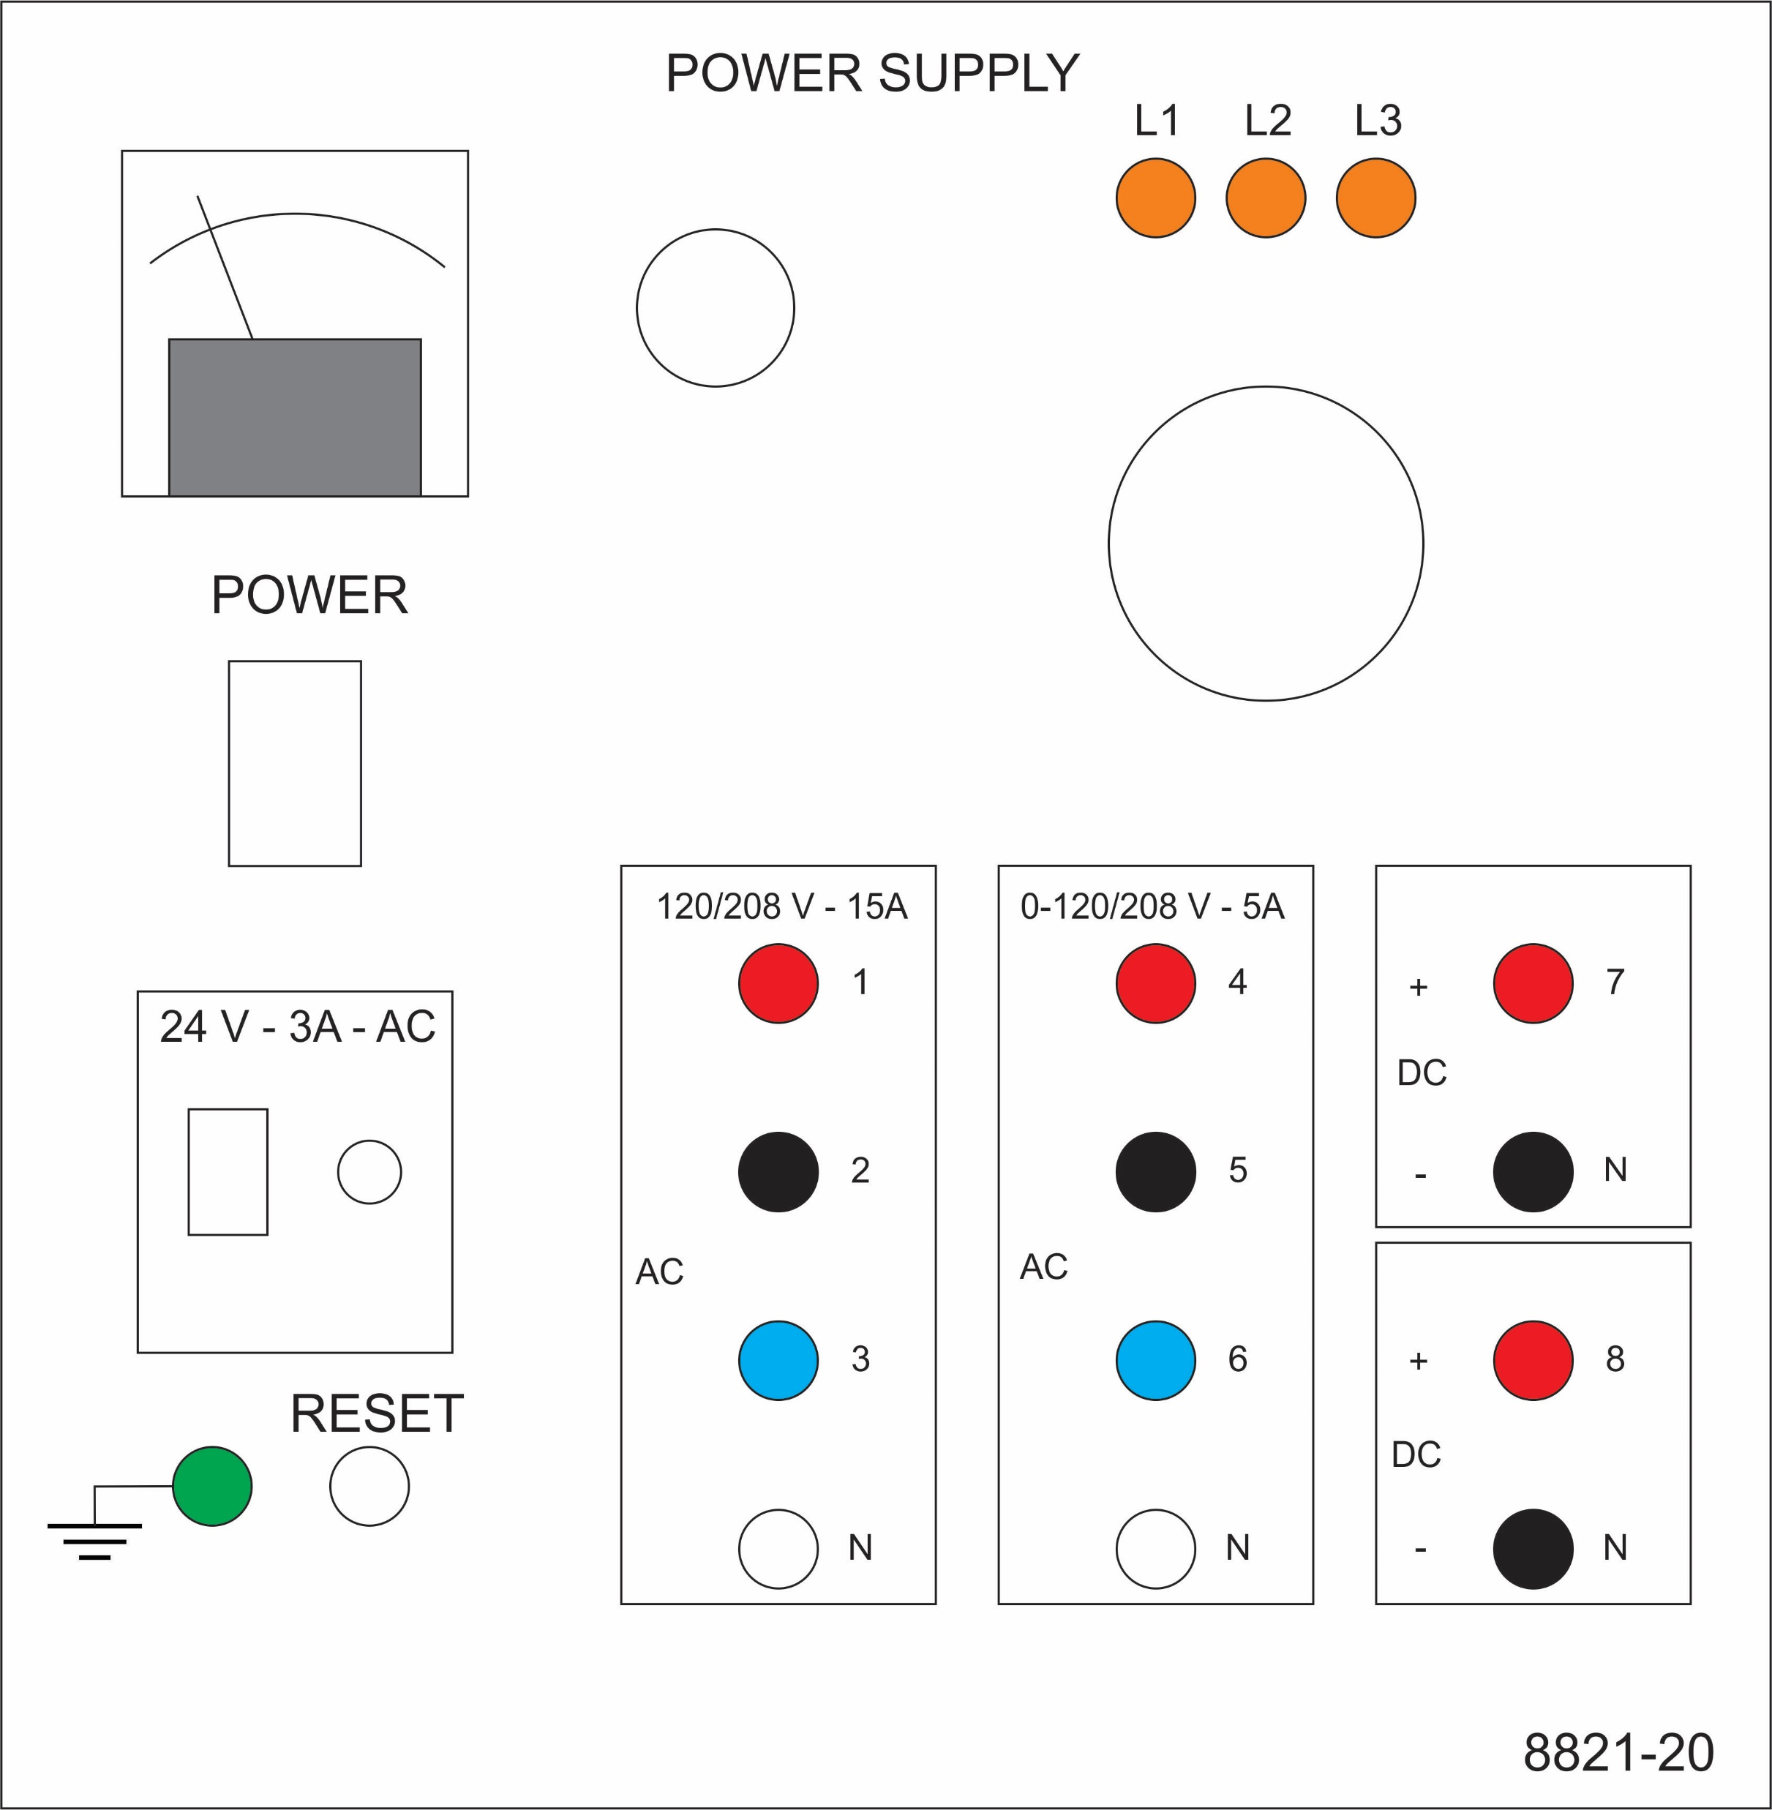
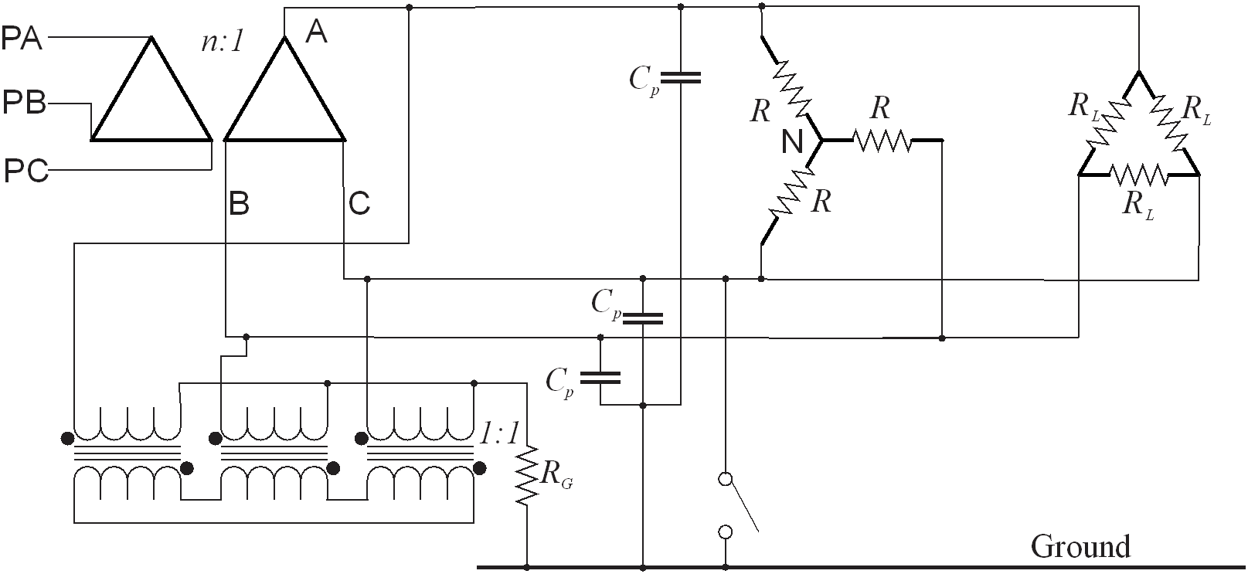
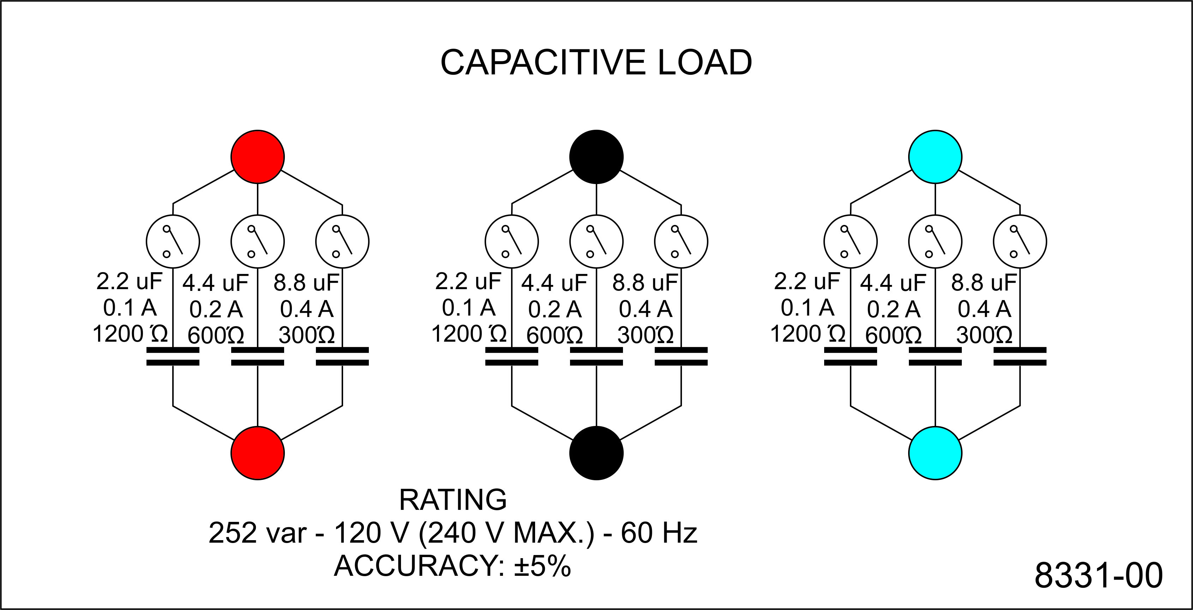
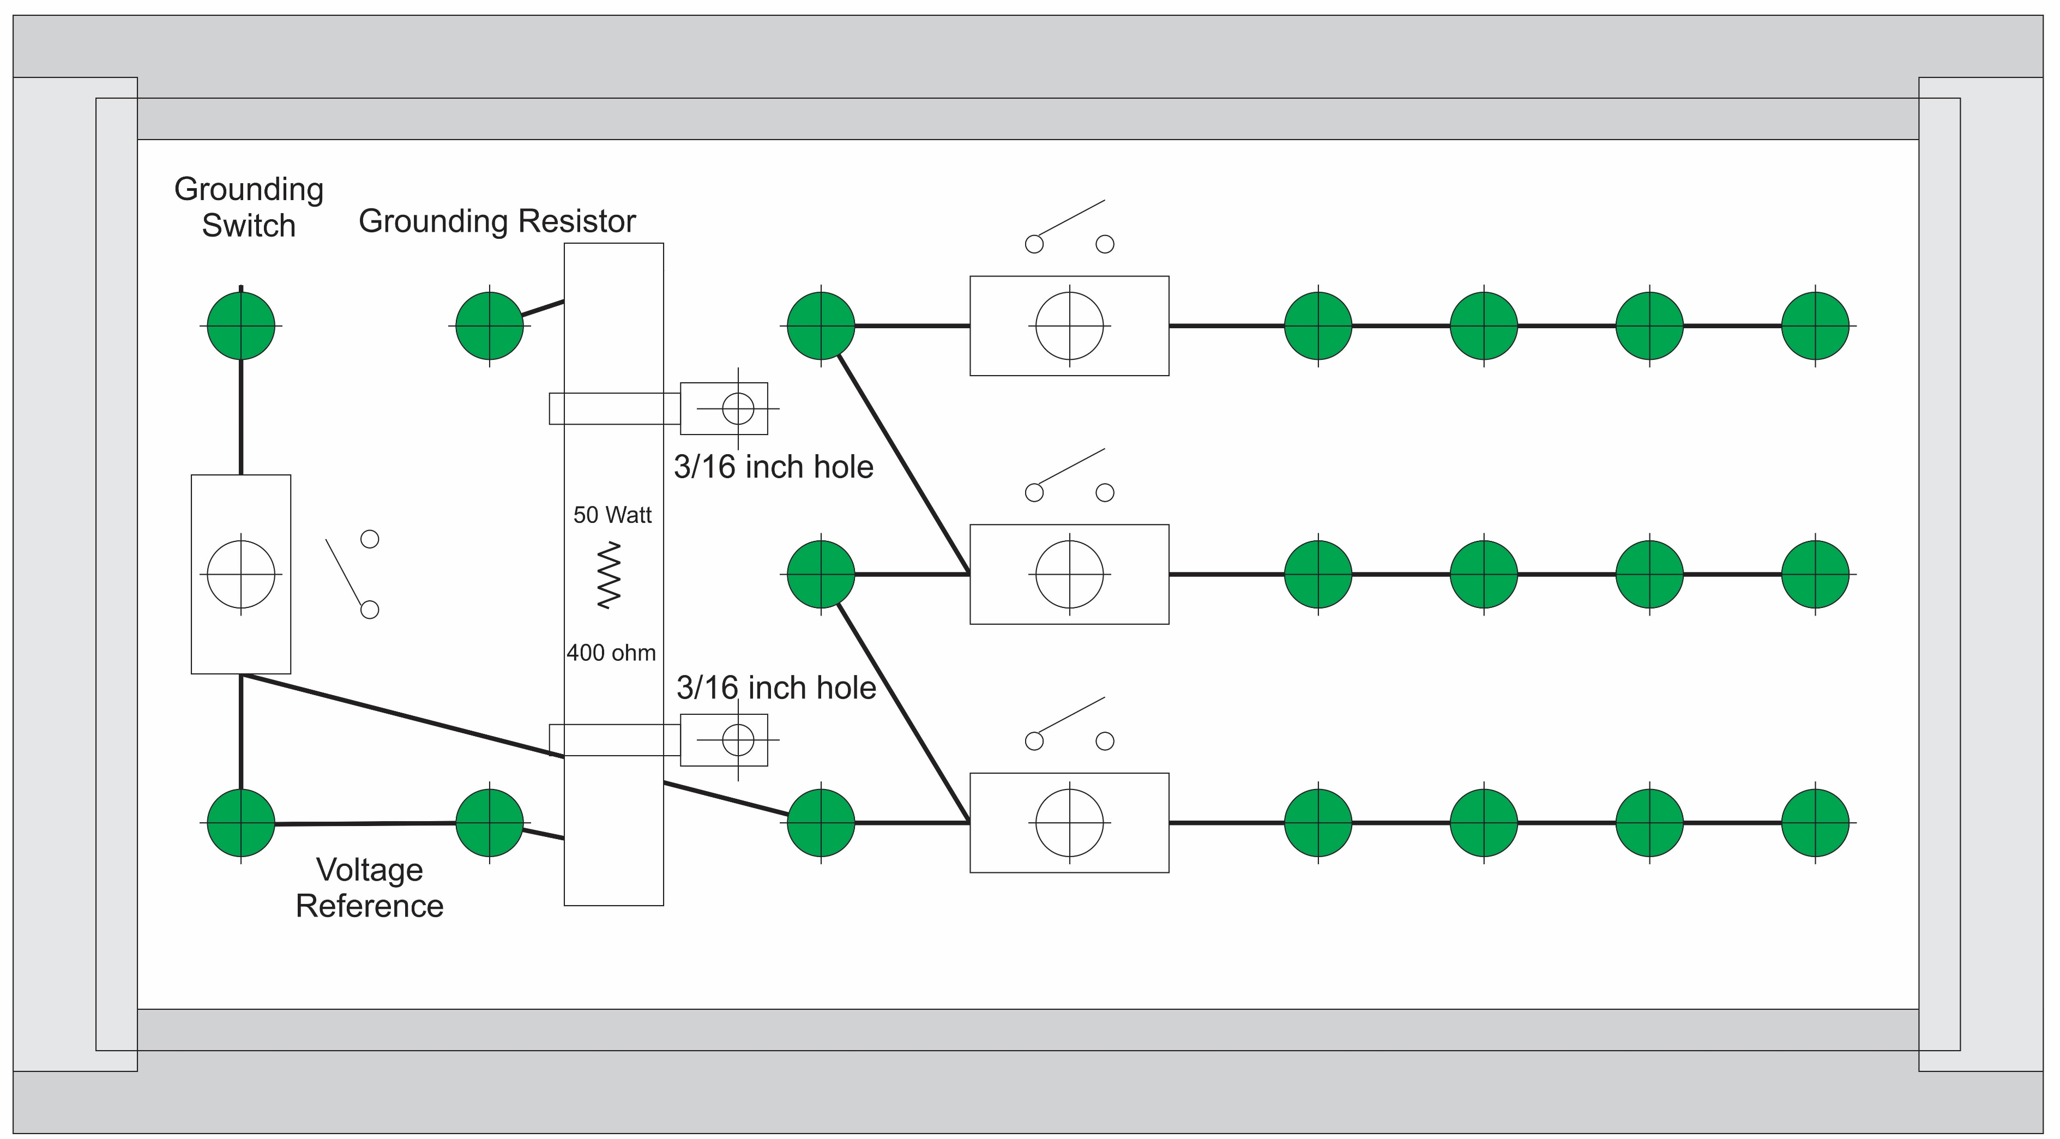
Experiment 13
Secondary - LL
Secondary - LN
Secondary - LG
Load line
Wye
Delta-Load
Parasitic

Slide 4
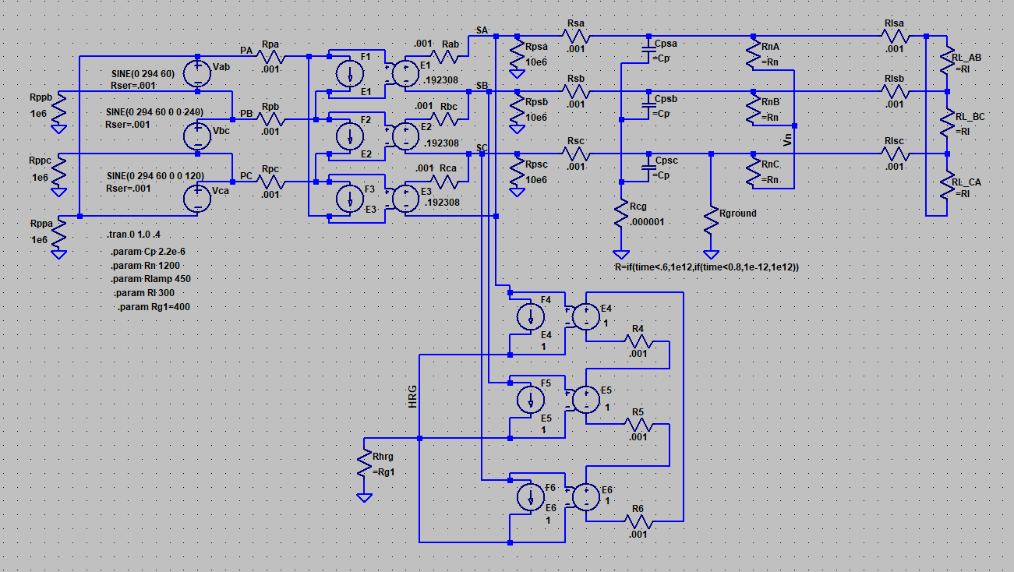
Simulation Model
LTspice
20241105 experiment 13.asc

Slide 5
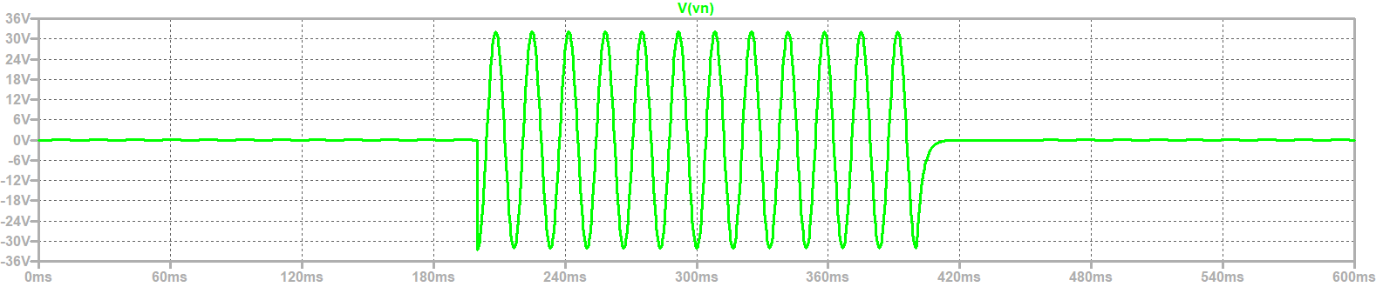
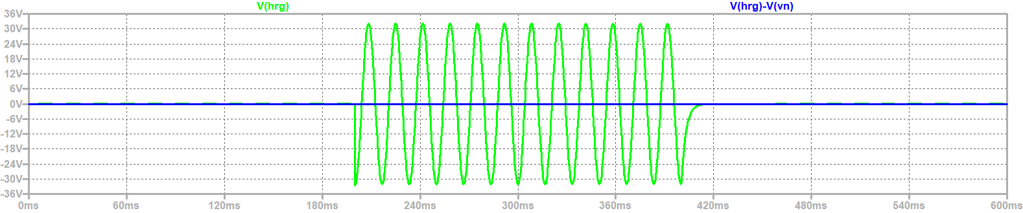
Neutral to ground voltage
HRG resistor voltage – HRG resistor to neutral voltage
Neutral to Ground Voltage
HRG to ground voltage – HRG to neutral voltage

Slide 6
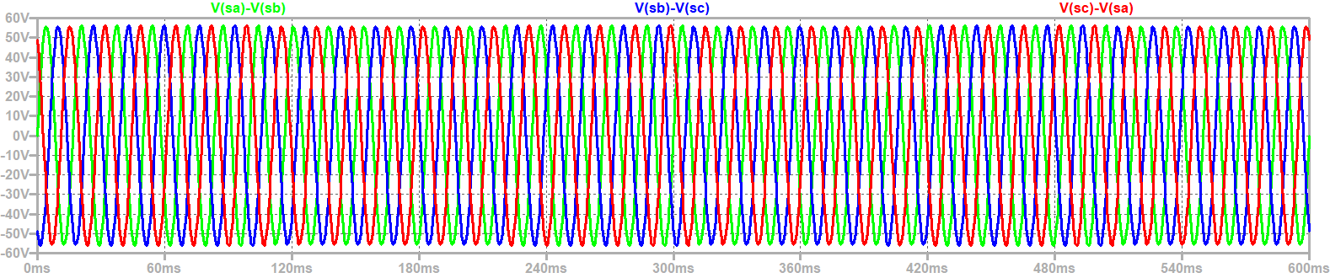
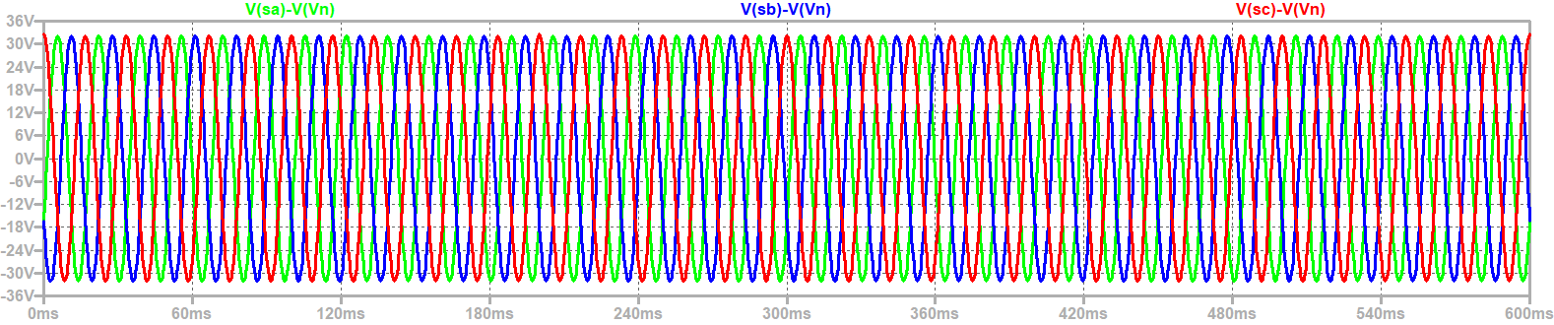
Steady State Voltages
Line to line voltage
Line to neutral voltage
Ground Fault

Slide 7
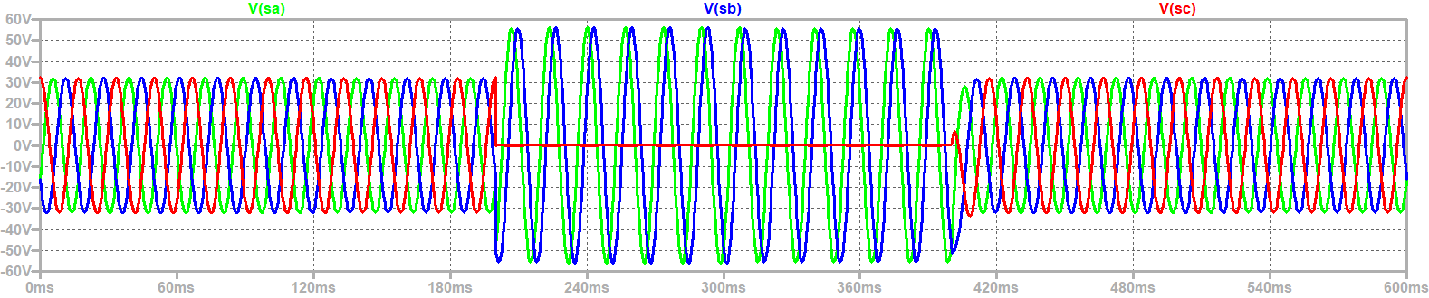
Steady State line to ground Voltages

Slide 8
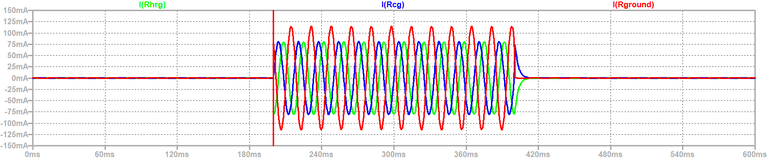
HRG resistor current, Parasitic Capacitance ground current, and fault current

Slide 9
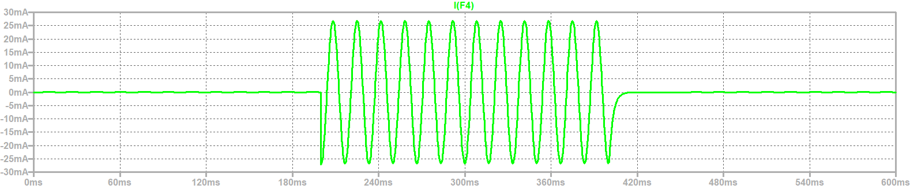
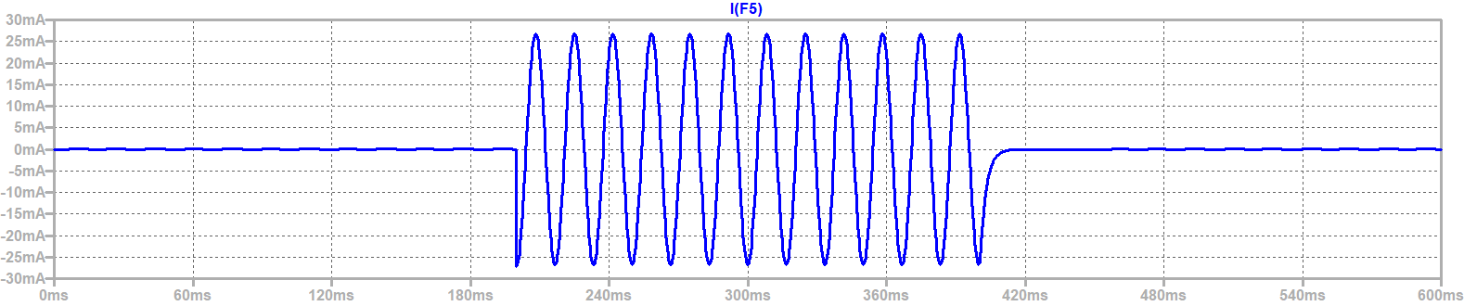
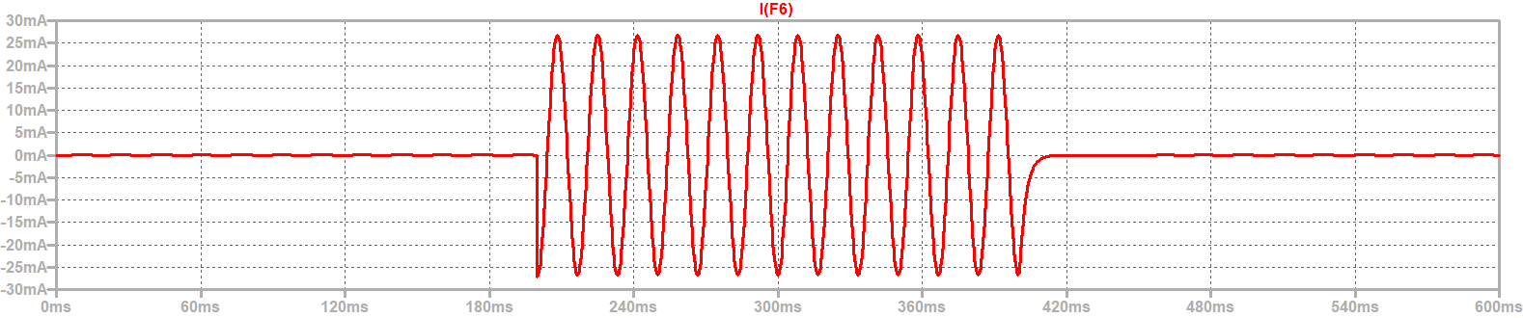
Current in grounding transformer

Slide 10
Wrap Up

